Slide 1

Unit 7

Slide 2
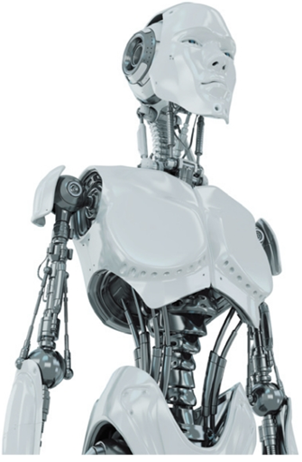
Do You Think You Will Have Your Own Robot?
para 3: Scientists are now trying to make robots look like humans and do the same things as we do. Some robots in Japan can walk and dance. They are fun to watch. However, some scientists believe that although we can make robots move like people, it will be difficult to make them really think like a human. For example, scientist James White thinks that robots will never be able to wake up and konw where they are. But many scientists disagree with Mr. White. They think that robots will even be able to talk like humans in 25 to 50 years.
Para. 1 Will robots think like humans in the future?
Para. 2 What will robots be like in the future?
Para. 3 What can robots do today?
Para. 4 What are robots like in movies?

Slide 3
para 4: Some scientists believe that there will be more robots in the future. However, they agree it may take hundreds of years. These new robots will have many different shapes. Some will look like humans, and others might look like animals.(Future)/
In India, scientists made robots that look like snakes. If buildings fall down with people inside, these snake robots can help look for people under the buildings. This was not possible 20 years ago, but computers and rockets also seemed impossible 100 years ago. We never know what will happen in the future.(Today)
Para. 1 Will robots think like humans in the future?
Para. 2 What will robots be like in the future?
Para. 3 What can robots do today?
Para. 4 What are robots like in movies?

Slide 4
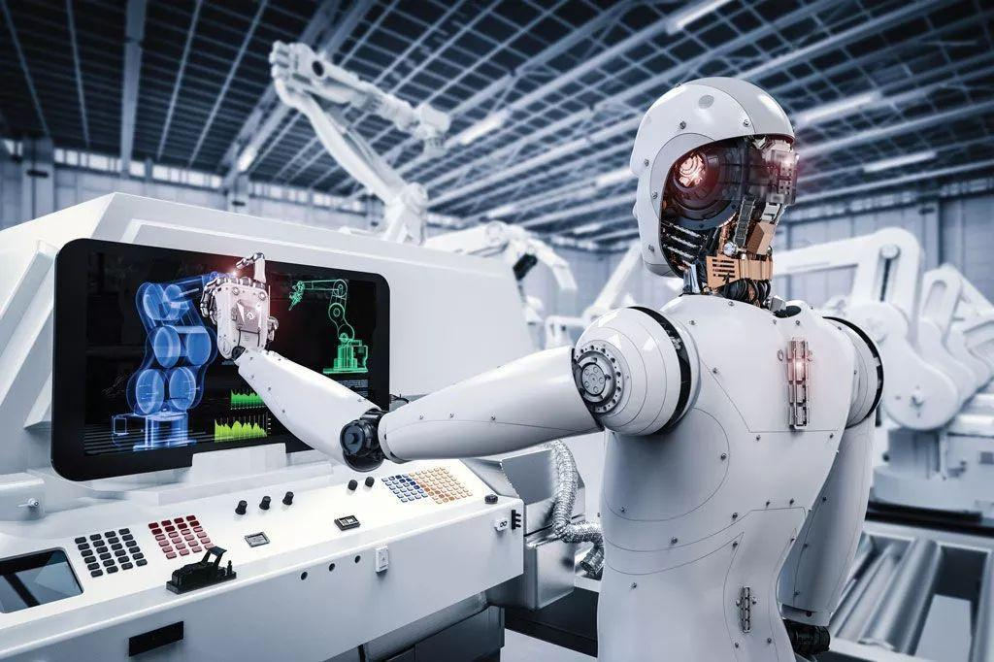
Unit 7
Will people have robots?

Slide 5
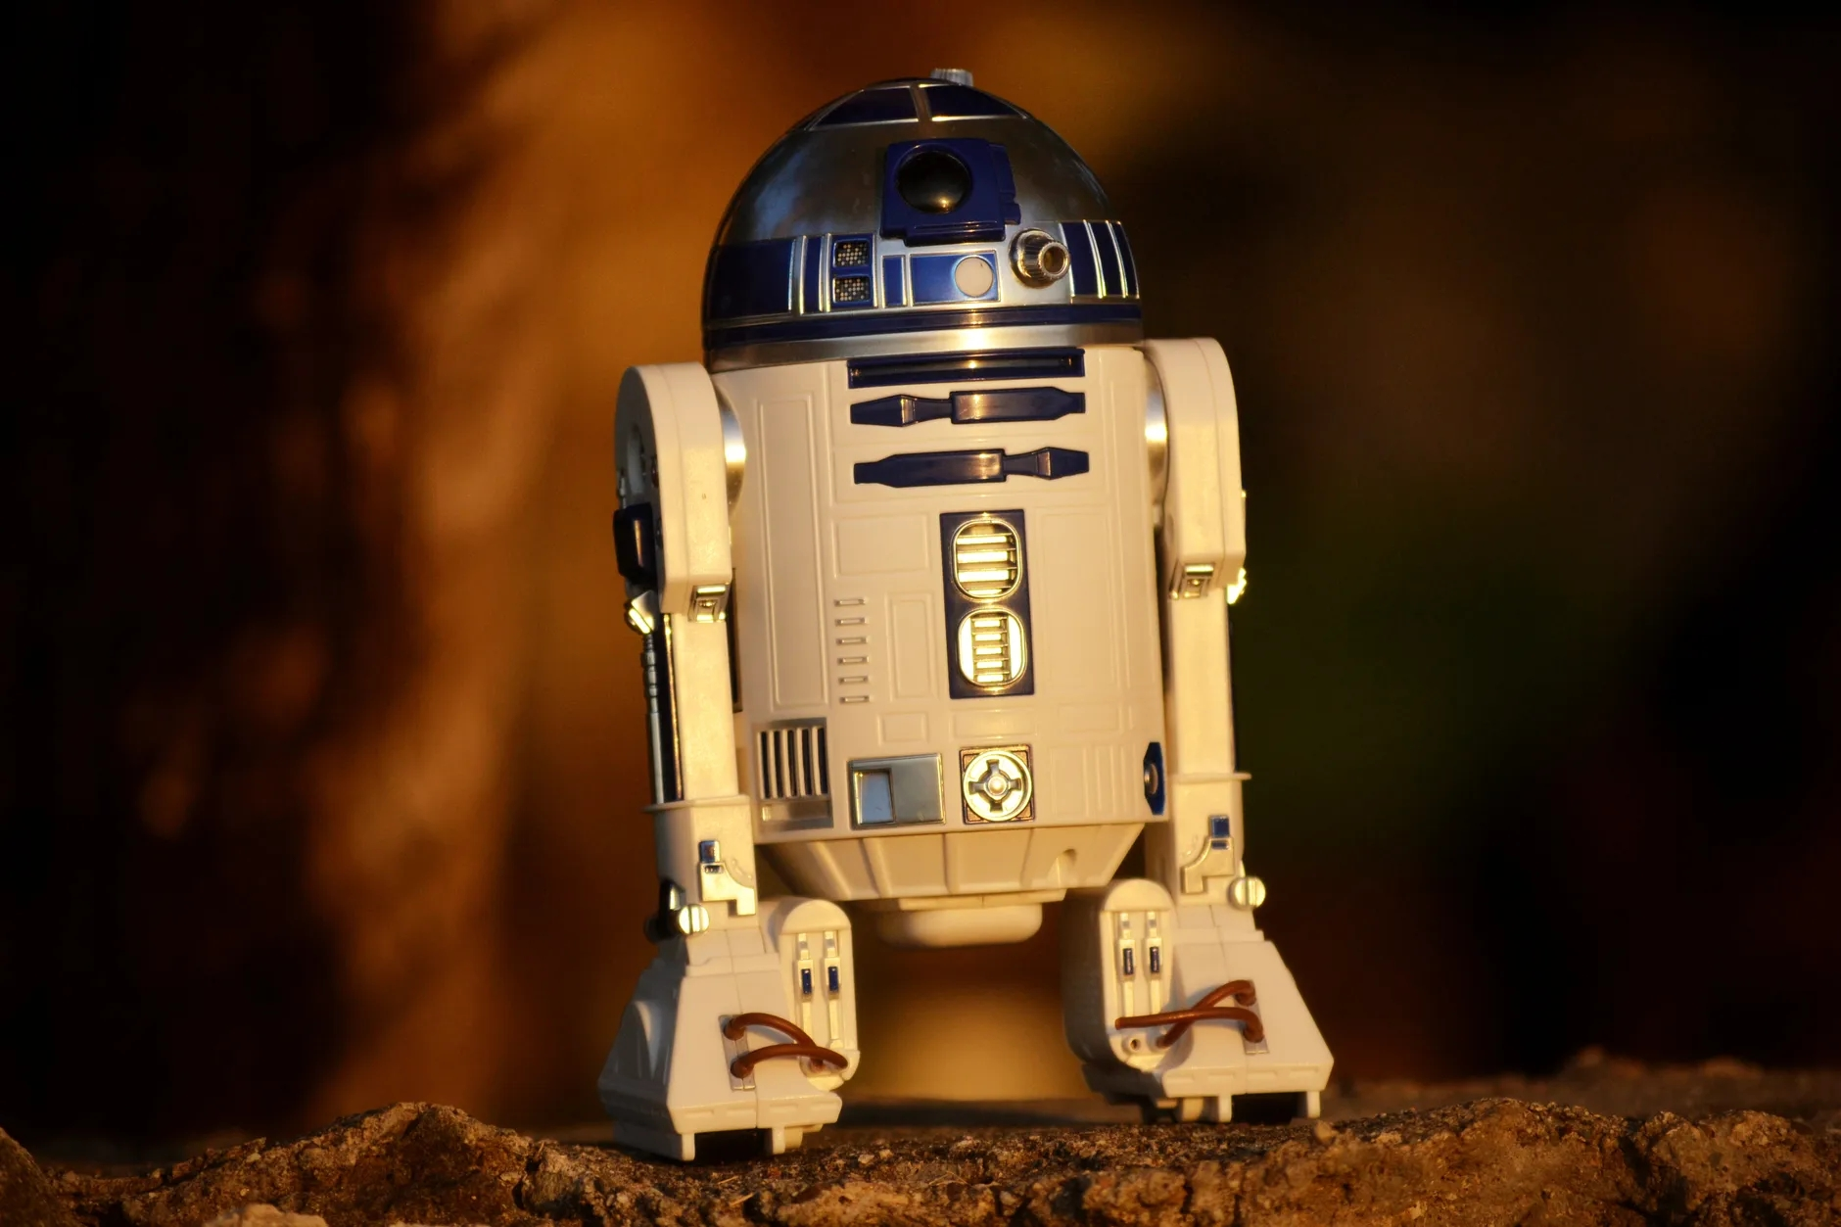


Slide 6


Discussion
Tell your partner what you know about robots. What do they look like and what can they do?

Slide 7
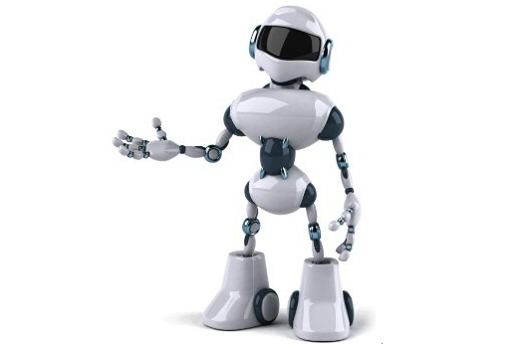
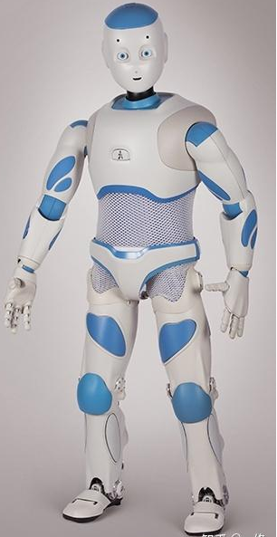
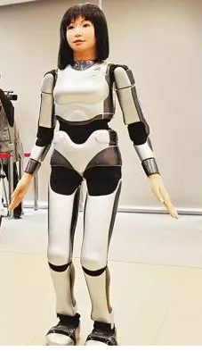
—What do the robots look like?
—They look like humans.
n. 人; adj. 人的

Slide 8
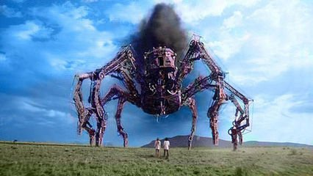
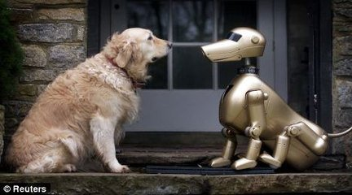
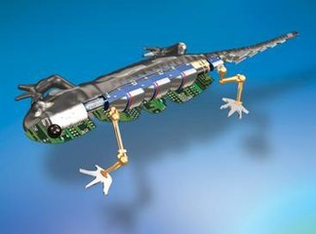
—What do the robots look like ?
—They look like animals.

Slide 9
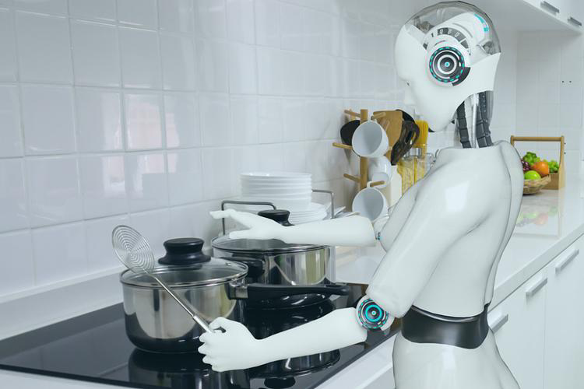
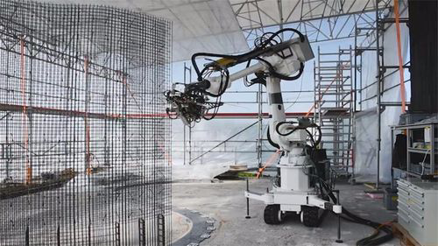
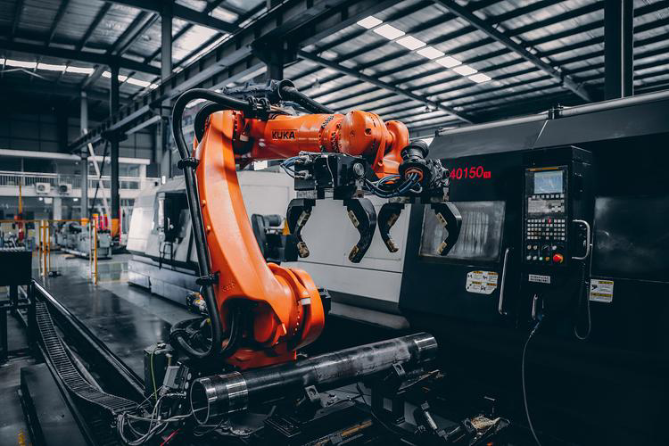
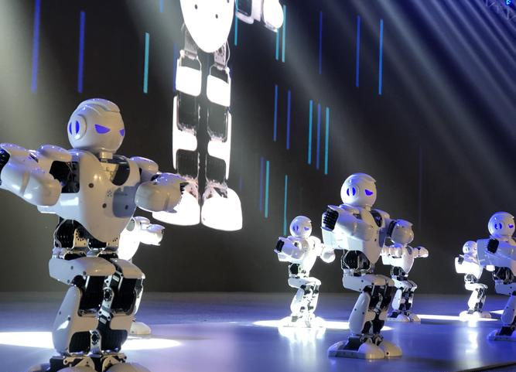
What can robots do?
They can do anything men can do.
The robots can help with the housework.
They can work in dangerous and dirty places.
They can work in factories and do simple jobs over and over again.
They can dance.
adj. 有危险的
n. 工厂
多次；反复地

Slide 10


Listen to an article about robots first.
Read the four paragraphs one by one carefully.精读
Match each paragraph with the question it discusses and find out the answer.配对并回答
Para. 1 Will robots think like humans in the future?
Para. 2 What will robots be like in the future?
Para. 3 What can robots do today?
Para. 4 What are robots like in movies?
Underline the useful expressions.划出重点短语

Slide 11
What’s the question para1 discusses?
Read and underline the useful expressions.
Do You Think You Will Have Your Own Robot?
para 1: When we watch movies about the future, we sometimes see robots. They are usually like human servants. They help with the housework and do jobs like working in dirty or dangerous places.
Para. 1 Will robots think like humans in the future?
Para. 2 What will robots be like in the future?
Para. 3 What can robots do today?
Para. 4 What are robots like in movies?

Slide 12
What’s the question para 2 discusses?
Read and underline the useful expressions.
para 2: Today there are already robots working in factories. Some can help to build cars, and they do simple jobs over and over again. Fewer people will do such jobs in the future because they are boring, but robots will never get bored.
Para. 1 Will robots think like humans in the future?
Para. 2 What will robots be like in the future?
Para. 3 What can robots do today?
Para. 4 What are robots like in movies?

Slide 13
Useful Expressions
Do You Think You Will Have Your Own Robot?
para 1: When we watch movies about the future, we sometimes see robots. They are usually like human servants(n.仆人). They help with the housework and do jobs like working in dirty or dangerous places.
Para. 1 Will robots think like humans in the future?
Para. 2 What will robots be like in the future?
Para. 3 What can robots do today?
Para. 4 What are robots like in movies?

Slide 14
Useful Expressions
para 2: Today there are already(adv.已经) robots working in factories. Some can help to build cars, and they do simple jobs over and over again. Fewer people will do such jobs in the future because they are boring, but robots will never get bored.
Para. 1 Will robots think like humans in the future?
Para. 2 What will robots be like in the future?
Para. 3 What can robots do today?
Para. 4 What are robots like in movies?

Slide 15
What’s the question para 3 discusses?
How many ideas about the robots are here? What are they?
Read and answer the questions.
para 3: Scientists are now trying to make robots look like humans and do the same things as we do. Some robots in Japan can walk and dance. They are fun to watch. However, some scientists believe that although we can make robots move like people, it will be difficult to make them really think like a human. For example, scientist James White thinks that robots will never be able to wake up and konw where they are. But many scientists disagree with Mr. White. They think that robots will even be able to talk like humans in 25 to 50 years.
Para. 1 Will robots think like humans in the future?
Para. 2 What will robots be like in the future?
Para. 3 What can robots do today?
Para. 4 What are robots like in movies?

Slide 16
Here are two ideas about the robots.
Some scientists think that robots will be able to look like, move like, think like and talk like humans in the future.
Some scientists believe that robots won’t be able to really think like a human.
para 3: Scientists are now trying to make robots look like humans and do the same things as we do. Some robots in Japan(日本) can walk and dance. They are fun to watch. However, some scientists believe(相信) that although we can make robots move like people, it will be difficult to make them really think like a human. For example, scientist James White thinks that robots will never be able to wake up and konw where they are. But many scientists disagree with Mr. White. They think that robots will even(adv.甚至) be able to talk like humans in 25 to 50 years.

Slide 17
Read and learn the useful expressions.
para 3: Scientists are now trying to make robots look like humans and do the same things as we do. Some robots in Japan(日本) can walk and dance. They are fun to watch. However, some scientists believe(相信) that although we can make robots move like people, it will be difficult to make them really think like a human. For example, scientist James White thinks that robots will never be able to wake up and konw where they are. But many scientists disagree with Mr. White. They think that robots will even(adv.甚至) be able to talk like humans in 25 to 50 years.
Para. 1 Will robots think like humans in the future?
Para. 2 What will robots be like in the future?
Para. 3 What can robots do today?
Para. 4 What are robots like in movies?

Slide 18


Fill in the blanks to retell para 3. 完成短文对第3段进行复述。
dance
Some robots are very human-like. They can walk and ______ like people. Some scientists think that in the future they will _______ robots more like humans. This may not _______ in the near future, but at some point, robots will even be able to ________ like people. However, some scientists ________. James White believes that robots will not be able to do the _______ things as we can. For example, he thinks that robots will ________ be able to wake up and know where they are. Which side(n.一方) do you ________ with?
make
happen
talk
disagree
same
never
agree

Slide 19
n-like (adj): 像...一样的；形似...的；类似于...的
例：a bird-like building
一座像鸟一样的建筑物
human-like
真人一样的
a cabbage-like vegetable
一种形似卷心菜的蔬菜
at some point 在某个时间点

Slide 20
What’s the question para 4 discusses?
Read and underline the useful expressions.
para 4: Some scientists believe that there will be more robots in the future. However, they agree it may take hundreds of years. These new robots will have many different shapes. Some will look like humans, and others might look like animals. In India, scientists made robots that look like snakes. If buildings fall down with people inside, these snake robots can help look for people under the buildings. This was not possible 20 years ago, but computers and rockets also seemed impossible 100 years ago. We never know what will happen in the future.
Para. 1 Will robots think like humans in the future?
Para. 2 What will robots be like in the future?
Para. 3 What can robots do today?
Para. 4 What are robots like in movies?

Slide 21
Useful Expressions
para 4: Some scientists believe that there will be more robots in the future. However, they agree it may take hundreds of years. These new robots will have many different shapes(n.形状). Some will look like humans, and others might look like animals. In India, scientists made robots that look like snakes. If buildings fall down(倒塌) with people inside, these snake robots can help look for people under the buildings. This was not possible(adj.可能的) 20 years ago, but computers and rockets also seemed impossible 100 years ago. We never know what will happen in the future.
Para. 1 Will robots think like humans in the future?
Para. 2 What will robots be like in the future?
Para. 3 What can robots do today?
Para. 4 What are robots like in movies?

Slide 22
Summary
Para. 1 What robots are like in movies.
They are usually like human servants.
Para. 2 What robots can do today.
They can work in factories, help to build cars and do simple jobs.
Para. 3 If robots will think or talk like humans in the future.
James White thinks they won’t, but many scientists thinks they will.
Para. 4 What robots will be like in the future.
There will be more robots and they will have many different shapes.

Slide 23

What can robots can do now?
cars
1. Robots can build __________ in factories.
2. They can do _________ jobs many times and never get bored.
3. Some can _________ and _________.
4. Some can help _______ people under _________.
simple
walk
dance
look for
buildings

Slide 24
Useful Expressions
para 4: Some scientists believe that there will be more robots in the future. However, they agree it may take hundreds of years. These new robots will have many different shapes(n.形状). Some will look like humans, and others might look like animals. In India, scientists made robots that look like snakes. If buildings fall down(倒塌) with people inside, these snake robots can help look for people under the buildings. This was not possible(adj.可能的) 20 years ago, but computers and rockets also seemed impossible 100 years ago. We never know what will happen in the future.
Para. 1 Will robots think like humans in the future?
Para. 2 What will robots be like in the future?
Para. 3 What can robots do today?
Para. 4 What are robots like in movies?

Slide 25
Summary
Para. 1 What robots are like in movies.
They are usually like human servants.
Para. 2 What robots can do today.
They can work in factories, help to build cars and do simple jobs.
Para. 3 If robots will think or talk like humans in the future.
James White thinks they won’t, but many scientists thinks they will.
Para. 4 What robots will be like in the future.
There will be more robots and they will have many different shapes.

Slide 26
What can robots can do now?
cars
1. Robots can build __________ in factories.
2. They can do _________ jobs many times and never get bored.
3. Some can _________ and _________.
4. Some can help _______ people under _________.
simple
walk
dance
look for
buildings

Slide 28
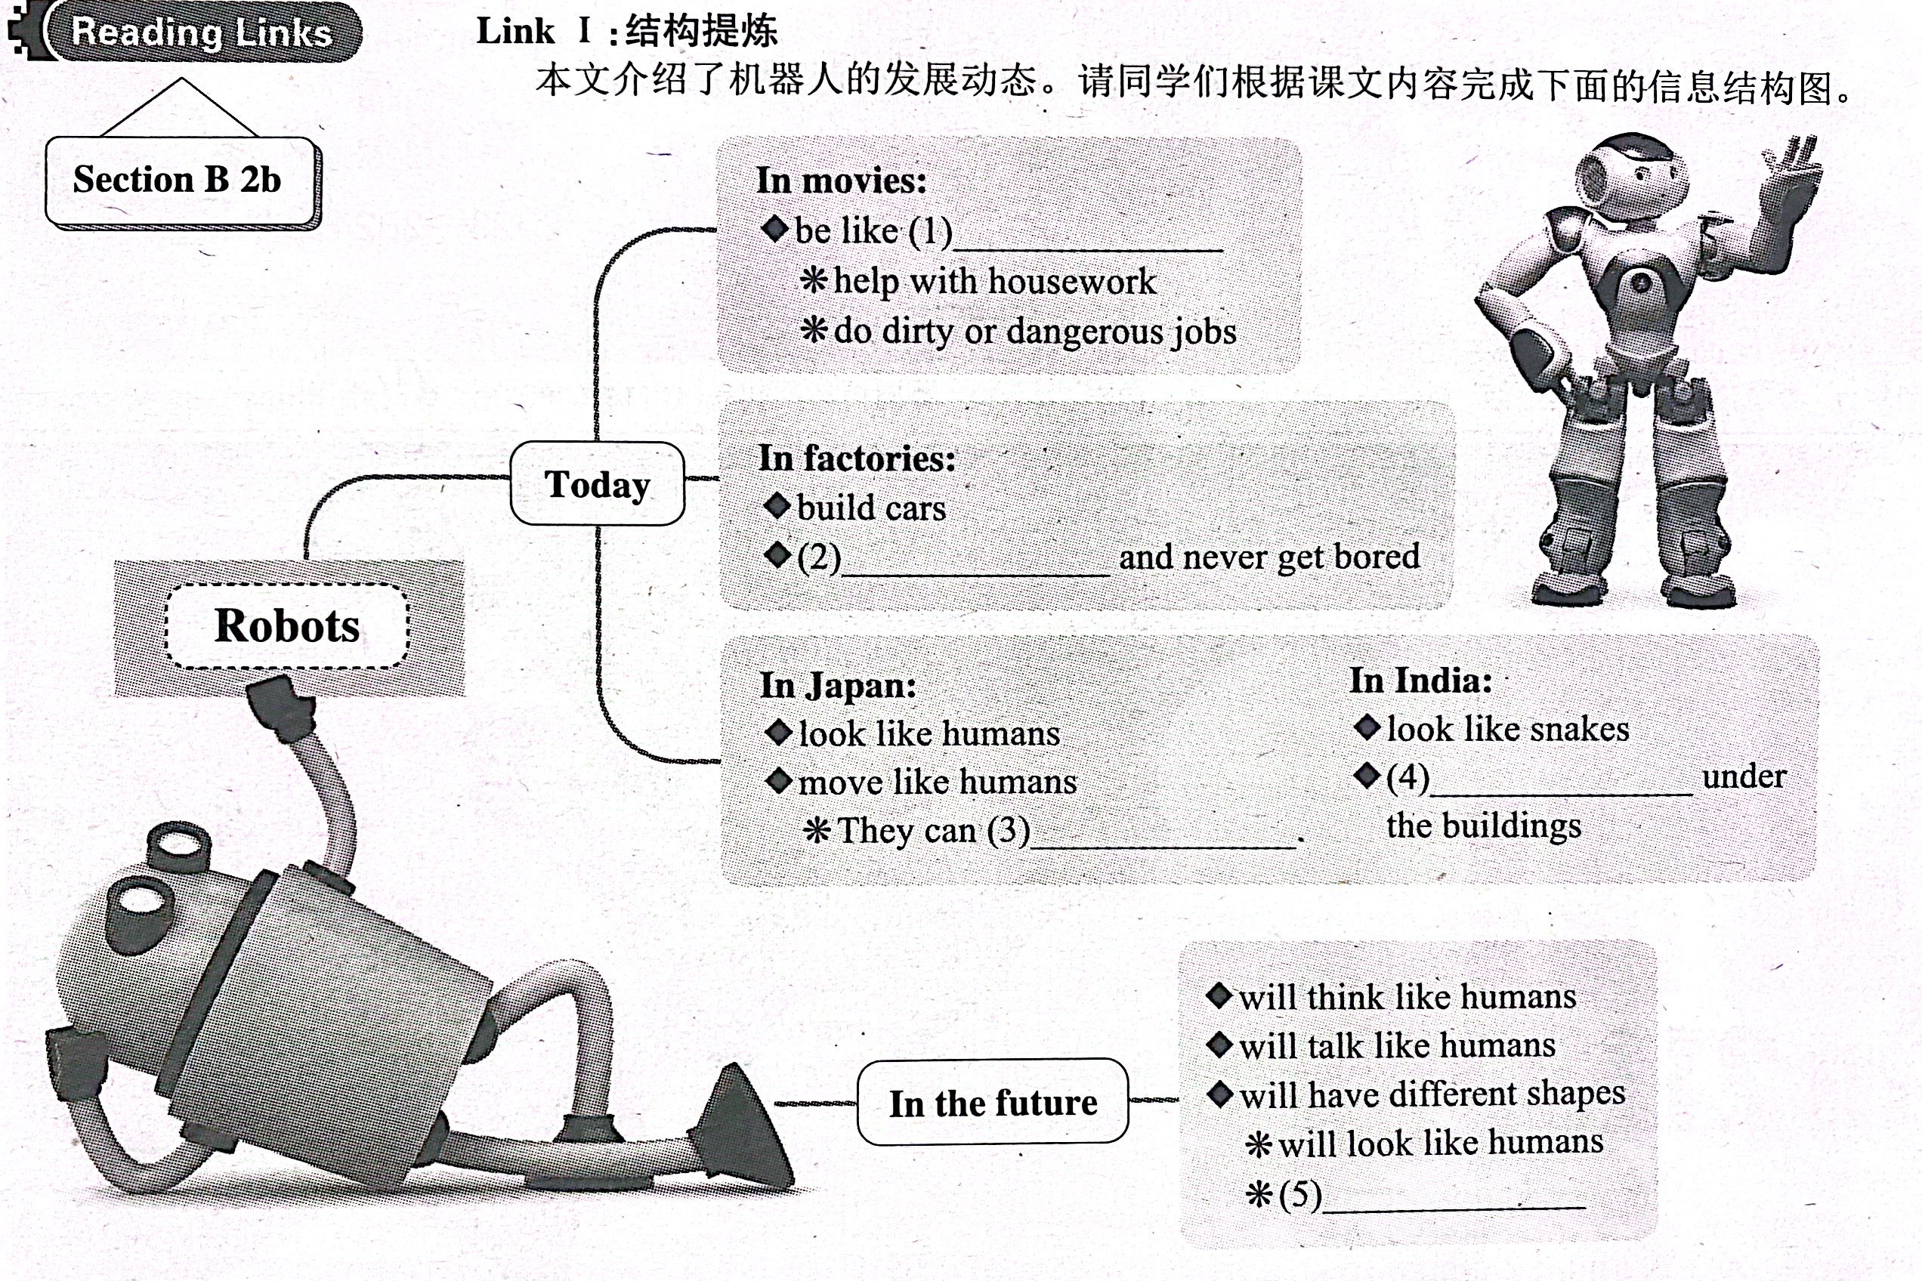
human servants
do simple jobs over and over again
help look for people
walk and dance
will look like animals

Slide 29



What kinds of animals might robots look like in the future? What do you think these robots will be able to do? Write your ideas and discuss them with your partner.
I think some future robots might look like _________. They will ____________________________________
____________________________________________.

Slide 30
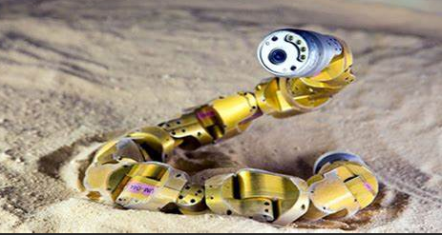
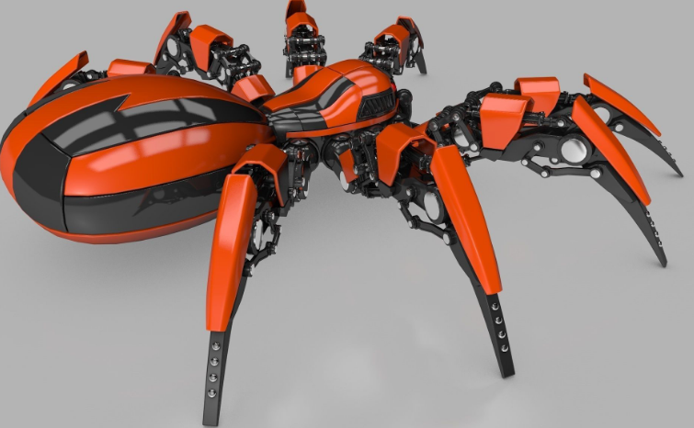
I think some future robots might look like snakes. They will can/be able to help look for people under the buildings if buildings fall down with people inside.
I think some future robots might look like spiders. They will be able to help humans clean the window and sweep the floor.

Slide 32
I think some future robots might look like people. They will be able to sing, dance and talk with us. They will also be able to serve us. They can make dinner, do the dishes and make coffee for us.
I think some future robots might look like big arms. They will be able to work in factories. They can help make cars and do simple jobs over and over again.

Slide 33

I think we will have robots for cleaning the house.
I think we will have robots for cleaning the house and washing the car.
I think we will have robots for cleaning the house, washing the car and doing the shopping.
I think we will have robots for…
I think we will have robots for…

Slide 34

Useful patterns you may use when discussing with a partner:
I agree with you that …
I hope so.
Yeah, probably.
Well, I don’t think…
Oh, I disagree.
You do? I think…
What will robots look like in the future?
What will robots …?

Slide 35


help with the housework 帮忙做家务
in dirty or dangerous places 在肮脏或危险的地方
over and over again 多次；反复地
look like 看起来像
wake up 醒来
disagree with 不同意；不赞成
hundreds of 成百上千；许多；大量
fall down 突然倒下；跌倒；倒塌
look for 寻找；寻求
fly up into the sky 飞向天空

Slide 36
Do You Think You Will Have Your Own Robot?
para 1: When we watch movies about the future, we sometimes see robots. They are usually like human servants. They help with the housework and do jobs like working in dirty or dangerous places.
para 2: Today there are already robots working in factories. Some can help to build cars, and they do simple jobs over and over again. Fewer people will do such jobs in the future because they are boring, but robots will never get bored.

Slide 37
para 3: Scientists are now trying to make robots look like humans and do the same things as we do. Some robots in Japan can walk and dance. They are fun to watch. However, some scientists believe that although we can make robots move like people, it will be difficult to make them really think like a human. For example, scientist James White thinks that robots will never be able to wake up and konw where they are. But many scientists disagree with Mr. White. They think that robots will even be able to talk like humans in 25 to 50 years.

Slide 38
para 4: Some scientists believe that there will be more robots in the future. However, they agree it may take hundreds of years. These new robots will have many different shapes. Some will look like humans, and others might look like animals. In India, scientists made robots that look like snakes. If buildings fall down with people inside, these snake robots can help look for people under the buildings. This was not possible 20 years ago, but computers and rockets also seemed impossible 100 years ago. We never know what will happen in the future.

Slide 40
Fill in the blanks in this paragraph with words from the article.
指导：
此类短文填空题，考查同学们全面掌握短文内容及综合运用语言的能力。
首先，通读本段文字，掌握大意。可知在短文中列举了科学家们的两种观点。
然后，根据2b中短文的内容填空。

Slide 41



To read the article and understand the main idea.
To get the main idea of each paragraph.
To learn to summarize the article.
To discuss how the robot will look like and what the robot will do in the future with a partner.

Slide 42


Translate the sentences.
1. —那是你的照片吗？
—是的，那是十年前的我。
2. —宇航员？你开玩笑的吧？
—不，我认真的。 我要乘火箭去月球。
—Is that a picture of you?
—Yes, that was me 10 years ago.
—An astronaut? Are you kidding?
—No, I’m serious. I’ll fly rockets to the moon.

Slide 43
3. —你会住在哪里？
—我将住在太空站。
4. 我将飞到其他星球上去。
—Where will you live?
—I’ll live on a space station.
I will fly to other planets.

Slide 44


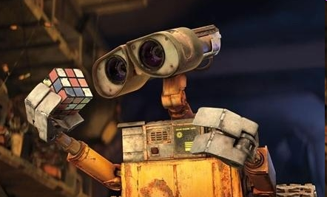
Do you know where the word “robot” was firstly used?

Slide 45
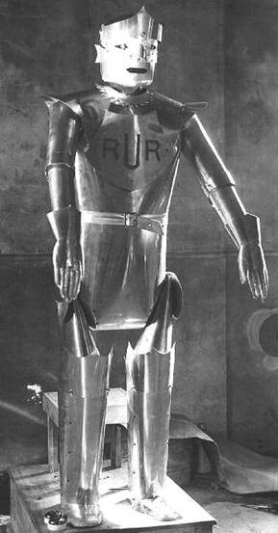
firstly used in a play Rossum’s Universal Robots by Karel Capek, a famous novelist (小说家) and playwright (剧作家)
a character who looks like humans and acts like humans named Robot

Slide 46
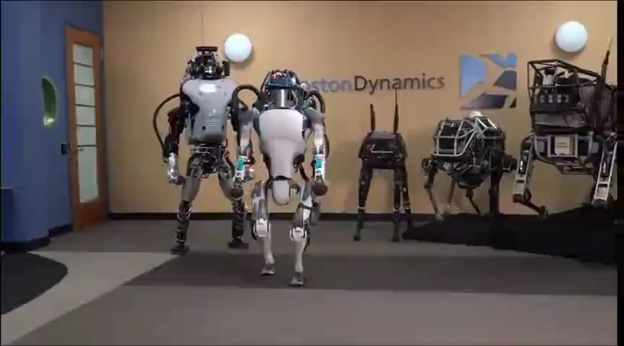
What do robots look like and what can they do? Watch the video.

Slide 47
Tell your partner what you know about robots. What do they look like and what can they do?
Really? What do they look like?
I think there will be more robots in the future.
I think they look like humans. They can do anything men can do.
Sounds interesting.

Slide 48
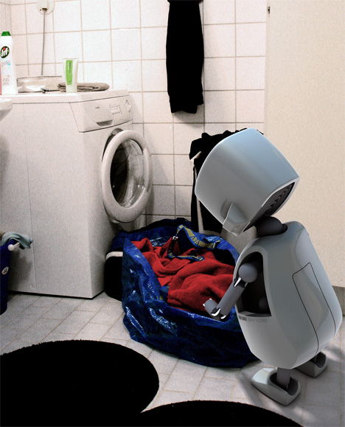
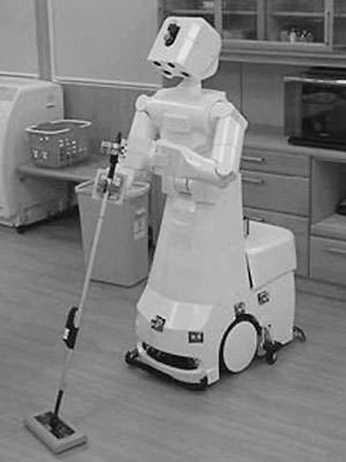
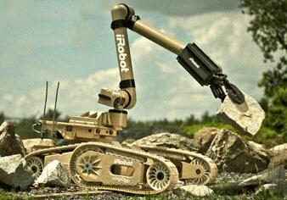
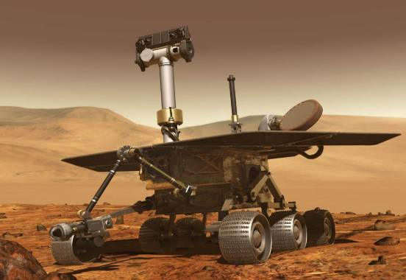
Do you know what things robots can do?
They can help with the housework and do jobs like working in dirty or dangerous places.

Slide 49

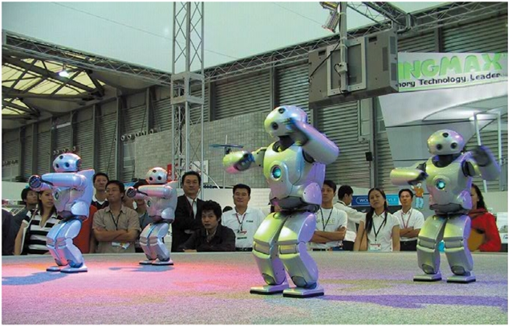
What does the writer want to tell us in the passage?
The passage tells us what robots can do now. It talks about robots in Japan and India. It also mentions two different opinions from scientists.

Slide 50

Read the article and match each paragraph with the question it discusses. Listen to the article first.
Para. 1 Will robots think like humans in the future?
Para. 2 What will robots be like in the future?
Para. 3 What can robots do today?
Para. 4 What are robots like in movies?

Slide 51
Read the article again quickly. Complete the sentences about what robots can do now.
cars
1. Robots can build __________ in factories.
2. They can do _________ jobs many times and never get bored.
3. Some can _________ and _________.
4. Some can help _______ people under _________.
simple
walk
dance
look for
buildings
寻找；寻求

Slide 52
Read the article carefully, then complete the table.
robots
Today’s robots
In movies
In real life
n.工厂
adj. 人的 n.人
They work in factories and never _________.
They’re like human servants.
n.仆人
get bored
They help with the housework and do ________ or dangerous jobs.
dirty
adj. 有危险的，不安全的

Slide 53
robots
Robots in the future
Their abilities
Their shapes
They can ________ like humans.
They may ___________ like humans.
They will even be able to talk like humans.
move
Some will look like ____________ and others might look like animals.
think
humans
adv.甚至；连；愈加

Slide 54
Retell the text.
We sometimes see robots in movies. They are usually like _________ servants. They do jobs like working in dirty or _________ places.
Today there are ________ robots working in ________. Some can help to build cars, and they do simple jobs _________________.
Some scientists _______ that although we can make robots move like people, it _______________ make them really think like a human. But many scientists _____________ this.
human
dangerous
adv. 已经, 早已
already
factories
多次，反复地
v. 相信, 认为有可能
over and over again
believe
will be difficult to
disagree with
v. 不同意; 持不同意见; 有分歧

Slide 55
许多, 大量
n. 形状；外形
even
They think that robots will __________ be able to talk like humans. It may take ___________ years to have more robots in the future. These robots __________ many different shapes. In India, scientists made robots look like snakes. If buildings __________ with people __________, these snake robots can help _________ people under the buildings. This was not __________ 20 years ago, but computers and rockets also seemed ___________ 100 years ago.
hundreds of
will have
fall down
inside
look for
possible
impossible
possible adj. 可能存在或发生的；可能的
impossible adj. 不可能存在或发生的；不可能的

Slide 56


Work in groups and discuss the questions:
What will robots look like in the future?
What will robots be able to do?
When will robots be available to average people?
Who will be the people to use the robots the most?

Slide 57

I. 从方框中选择合适单词填空，注意形式变化。
already, during, believe, probable, danger, even, side, shape, inside, factory
believe
1. I couldn’t _______ my eyes when I saw the test results.
2. It’s _______ 9:00 p.m. Let’s go home quickly.
3. She walked home by herself, although she knew it was _______.
4. It’s raining. We will have to go _______ the house.
5. Don’t wash your T-shirt too many times. I’m afraid it will lose its _______.
already
dangerous
inside
shape

Slide 58
already, during, believe, probable, danger, even, side, shape, inside, factory
6. A lot of workers lost their jobs when those two _______ closed (关闭).
7. This painting is good, but that one is _______ better.
8. —Do you think you can do it?
—Well, _______ I can.
9. There are two _______ to every story.
10. They work _______ the night and sleep in the daytime.
factories
even
probably
sides
during

Slide 59
Ⅱ. 根据汉语意思，完成英语句子，每空一词。
1. 公园里有一座很大的像鸟一样的建筑物。
There is a large _______ _______ in the park.
2. Bob告诉父母他的想法，但是他们和他有分歧。
Bob told his parents about his ideas, but they ________ _______ him.
3. 没有什么好怕的。天不会塌下来。
There is nothing to be afraid of. The sky won’t _______ _______.
bird-like building
disagreed with
fall down

Slide 60
4. 她像个机器人一样一遍又一遍地重复它。
She kept repeating it _______ _______ _______ _______ like a robot.
5. 看！图书馆里有许多正在看书的学生。
Look! _______ _______ many students _______ in the library.
6. 昨天那个游泳池里有数以百计的人。
There were ________ _______ people at that swimming pool yesterday.
7. 对我来说，给你一个确定的答复是不可能的。
It’s _________ _______ me _______ _______ you a definite answer.
over and over again
There are reading
hundreds of
impossible for to give

Slide 61
8. 我们到处找他，但是没有找到。
We _______ _______ him everywhere, but couldn’t find him.
9. 在2030年，他们将在月球上建另一个太空站。
They will build another _______ _______ on the moon in 2030.
looked for
space station

Slide 62


If you have a chance to design(设计) a robot, what will your robot look like? What can your robot do? How will your robot help you in your life? Write down your ideas.

Slide 63


